Slide 1
AGENDA
SQL processing
Identity High load SQL
SQL Statement Optimization
Optimizer Hints

Slide 2
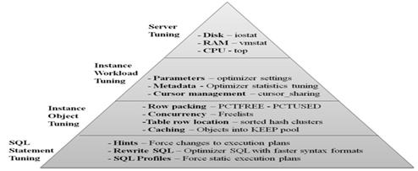
SQL tuning
It is a iterative process of improving SQL statement performance to meet specific,
measurable, and achievable goals.
Purpose: Reduce user response time
Improve throughput

Slide 3
CHALLENGES OF TUNING
SQL Tuning is Hard
Who should tune – DBA or Developer
Which SQL to tune
Requires Expertise in Many Areas
Technical – Plan, Data Access, SQL Design
Business – What is the Purpose of SQL?
Tuning Takes Time
Large Number of SQL Statements
Each Statement is Different
Low Priority in Some Companies
Vendor Applications
Focus on Hardware or System Issues
Never Ending

Slide 4
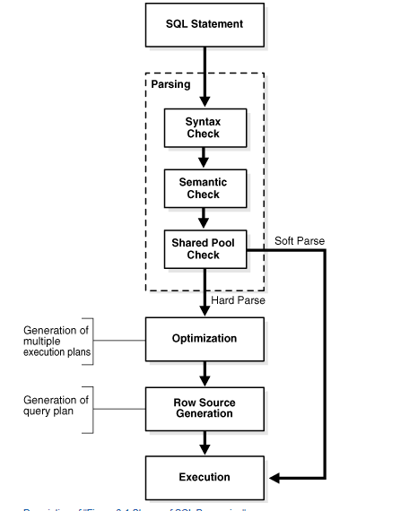
SQL processing

Slide 5
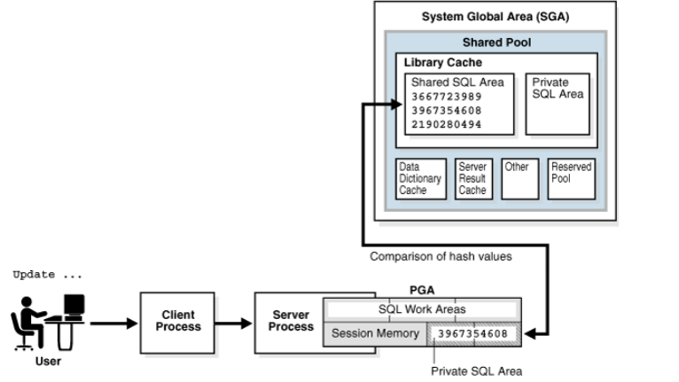
SQL Parsing
Syntax Check
Semantic Check
Shared Pool Check
Hard parse
Soft parse

Slide 6
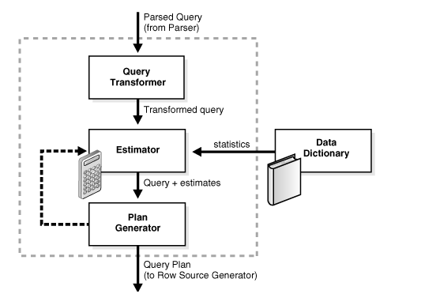
Query Optimizer Concepts
The optimizer choose the plan with the lowest cost among all considered candidate plans.
The optimizer uses available statistics to calculate cost.
For a specific query in a given environment, the cost computation accounts for factors of query execution such as I/O, CPU, and communication.

Slide 7
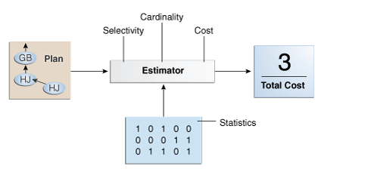
Estimator
The estimator uses three different measures to determine cost:
Selectivity
Cardinality
Cost

Slide 8
SQL Row Source Generation
The row source generator is software that receives the optimal execution plan from the optimizer and produces an iterative execution plan that is usable by the rest of the database.
An ordering of the tables referenced by the statement
An access method for each table mentioned in the statement
A join method for tables affected by join operations in the statement
Data operations such as filter, sort, or aggregation

Slide 9
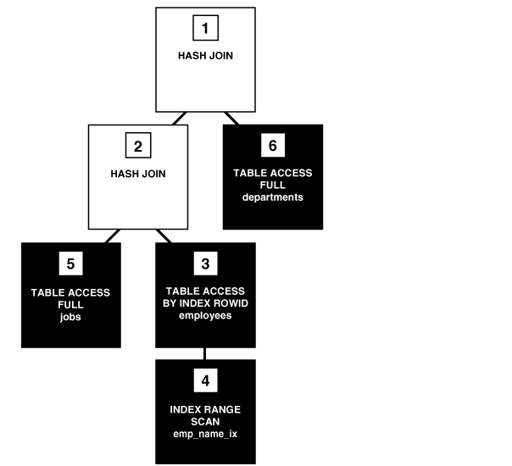
SQL Execution
The SQL engine executes each row source in the tree produced by the row source generator. This step is the only mandatory step in DML processing
Each step in an execution plan has an ID number
Steps indicated by the black boxes physically retrieve data from an object in the database
Steps indicated by the clear boxes operate on row sources

Slide 10
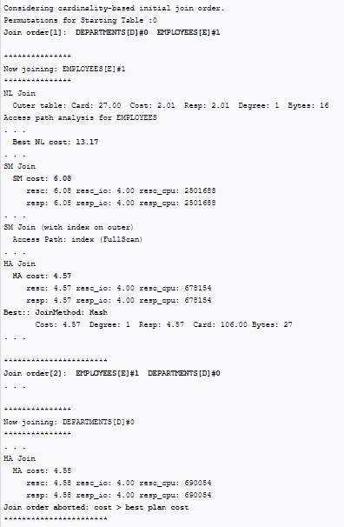
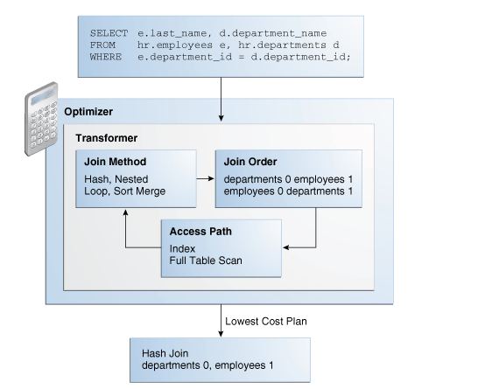
Plan Generator
The plan generator explores various plans for a query block by trying out different access paths, join methods, and join orders

Slide 11
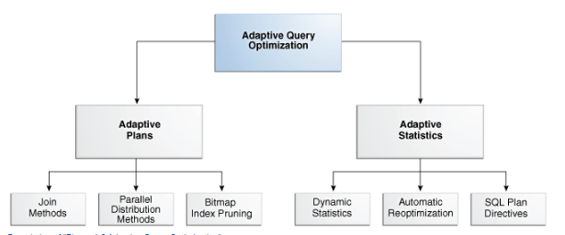
Adaptive Query Optimization
Adaptive query optimization enables the optimizer to make run-time adjustments to execution plans and discover additional information that can lead to better statistics

Slide 12
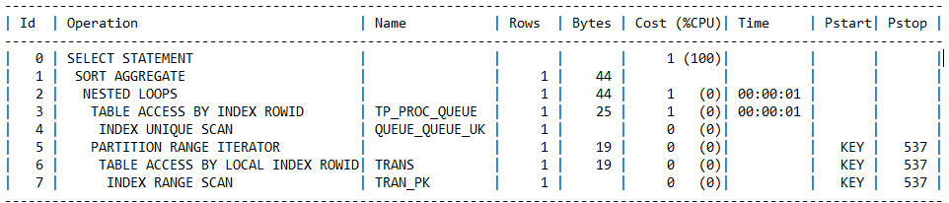
Execution Plan
An ordering of the tables referenced by the statement
An access method for each table mentioned in the statement
A join method for tables affected by join operations in the statement
Data operations like filter, sort, or aggregation
Optimization, such as the cost and cardinality of each operation
Partitioning, such as the set of accessed partitions

Slide 13
Access Path
An access path is a technique used by a query to retrieve rows from a row source
Full Table Scans
Table Access by Rowid
Sample Table Scans
Index Unique Scans
Index Range Scans
Index Full Scans
Index Fast Full Scans
Index Skip Scans
Index Join Scans
Bitmap Index Range Scans
Hash Scans

Slide 14
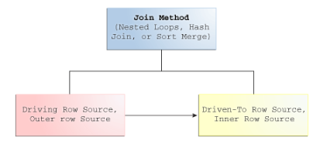
Joins
A join combines the output from exactly two row sources, such as tables or views, and returns one row source. The returned row source is the data set.
Nested Loops Joins
Hash Joins
Sort Merge Joins
Cartesian Joins

Slide 15
Tools to Identify High-Load SQL
The steps involved in identifying and gathering data on high-load SQL statements. High-load SQL are poorly-performing, resource-intensive SQL statements that impact the performance of an Oracle database.
The following tools can identify high-load SQL statements:
Automatic Database Diagnostic Monitor (ADDM)
Automatic SQL tuning
Automatic Workload Repository (AWR)
Active Session history report
SQL Trace

Slide 16
Optimizing SQL Statements
Verifying Optimizer Statistics
Reviewing the Execution Plan
Restructuring the SQL Statements
Restructuring the Indexes
Controlling the Access Path and Join Order

Slide 17
Verifying Optimizer Statistics
Table statistics
Number of rows
Number of blocks
Average row length
Column statistics
Number of distinct values (NDV) in a column
Number of nulls in a column
Data distribution (histogram)
Extended statistics
Index statistics
Number of leaf blocks
Number of levels
System statistics
I/O performance and utilization
CPU performance and utilization

Slide 18
Reviewing the Execution Plan
The driving table has the best filter.
The join order in each step returns the fewest number of rows to the next step (that is, the join order should reflect, where possible, going to the best not-yet-used filters).
The join method is appropriate for the number of rows being returned. For example, nested loop joins through indexes may not be optimal when the statement returns many rows.
The database uses views efficiently. Look at the SELECT list to see whether access to the view is necessary.
There are any unintentional Cartesian products (even with small tables).

Slide 19
Restructuring the SQL Statements
Avoid Transformed Columns in the WHERE Clause
Write Separate SQL Statements for Specific Tasks
Restructuring the Indexes
Remove nonselective indexes to speed the DML.
Index performance-critical access paths.
Consider reordering columns in existing concatenated indexes.
Add columns to the index to improve selectivity.

Slide 20
Controlling the Access Path and Join Order
Global hints: rule, first_rows, first_rows_n all_rows
Table join hints:use_nl, use_hash, ordered
Index hints:Specifies an index name
Table access hints: parallel, full, cardinality

Slide 21
Optimizer Hints
Optimizer hints can be used with SQL statements to alter execution plans.
optimization approach for a SQL statement
The goal of the cost-based optimizer for a SQL statement
Access path for a table accessed by the statement
Join order for a join statement
Join operation in a join statement

Slide 22
Few hints used in APS
FIRST_ROWS
INDEX
NO_INDEX
ORDERED
USE_NL
USE_MERGE
USE_HASH
LEADING

Slide 23
Questions
??????

Slide 24


